Slide 1
Child abuse in the U.S.
A brief summary in Tableau.

Slide 2
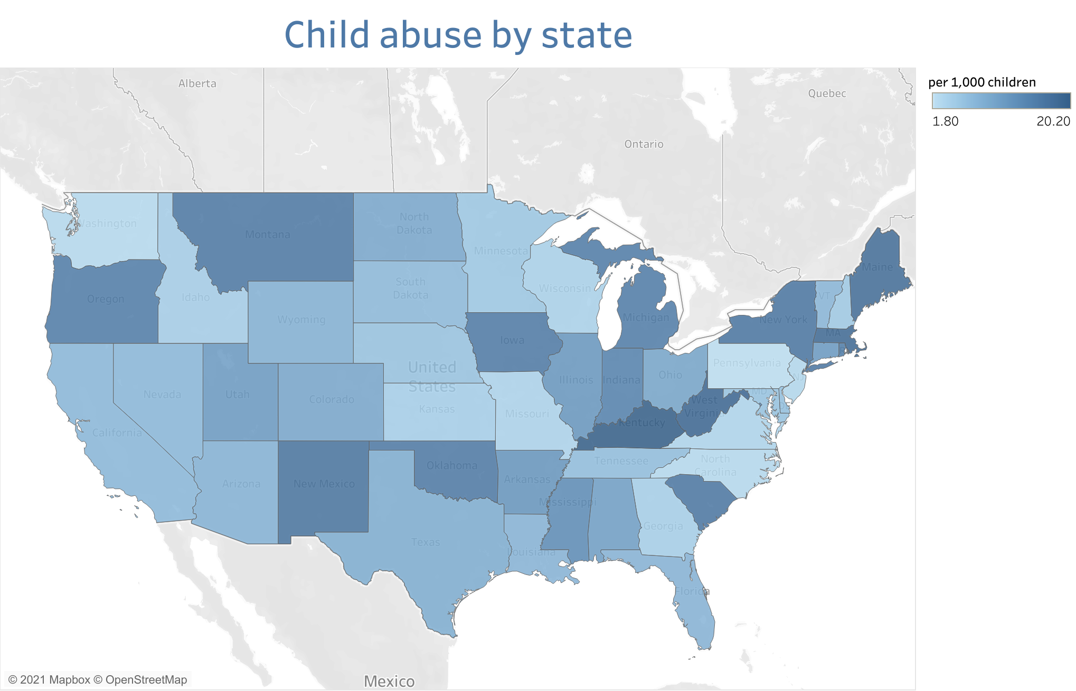

Slide 3
